Slide 1
CAPSTONE PROJECT
Analytical CRM Development
for a Bank
Turning four years of customer, account, and transaction data into a clear
view of why customers leave — and what will make them stay.
Prepared by SHREYASH RAWAT

Slide 2
ROADMAP
Table of Contents
01
Introduction
02
Problem Statement
What an Analytical CRM means for this bank
The cost of customer churn
03
Data Foundation
04
Churn Landscape
Sources, structure & data quality
Where, when & who is leaving
05
Root Cause Analysis
06
Strategy & Dashboard
What truly predicts churn
Recommendations and the live CRM view

Slide 3
01 · INTRODUCTION
What an Analytical CRM Means for This Bank
An Analytical CRM turns raw customer, account, and transaction records into a decision-making tool. Instead of reacting to attrition after the fact, the bank can segment its customer base, observe behavioral patterns, predict who is likely to leave, and act — before the relationship ends.
1
Segment
Group customers by behavior, geography, and value
2
Observe
Track engagement, product usage & activity over time
The goal of this project is simple: increase customer satisfaction and retention by tailoring offers and engagement based on what the data actually shows — not assumptions.
3
Predict
Identify the strongest signals of future churn
4
Act
Convert insight into targeted retention strategy

Slide 4
02 · PROBLEM STATEMENT
The Cost of Customer Churn
Customer churn — the rate at which customers discontinue using the bank’s services — directly erodes revenue and long-term profitability. This analysis examines churn through the lens of gender, recent trends, credit card ownership, product usage, credit score, and geography, with one goal: identify why customers leave, and what will make them stay.
20.37%
overall customer churn rate
Roughly 1 in every 5 customers
has already left the bank —
making retention this analysis’s
central question.
OUR OBJECTIVE
Pinpoint the drivers of attrition across demographic, financial, and behavioral dimensions — then translate every finding into a concrete strategy to lift retention.
10K
customer records analyzed, 2016–2019

Slide 5
03 · DATA FOUNDATION
A Clean, Relational View of the Customer
The dataset spans 7 relational tables built around one core fact table, joined by CustomerID. Every field below was validated — the data contains zero missing values.
CustomerID
CreditScore
Geography
Gender
Unique identifier for each customer
Numerical score → Poor / Good / Very Good / Excellent / Super
Customer’s country: France, Germany, or Spain
Male or Female
Age
Tenure
Balance
NumOfProducts
Customer age — key demographic driver of behavior
Years associated with the bank
Current account balance
Number of bank products subscribed to
HasCrCard
IsActiveMember
EstimatedSalary
Exited
Whether the customer holds a credit card
Actively engaged (1) vs. inactive (0)
Estimated annual income
Churn flag — 1 if the customer has left
7 tables analyzed · 5 purely categorical (Gender, Geography, Active status, Exit status, Credit Card) · 0 missing values found

Slide 6
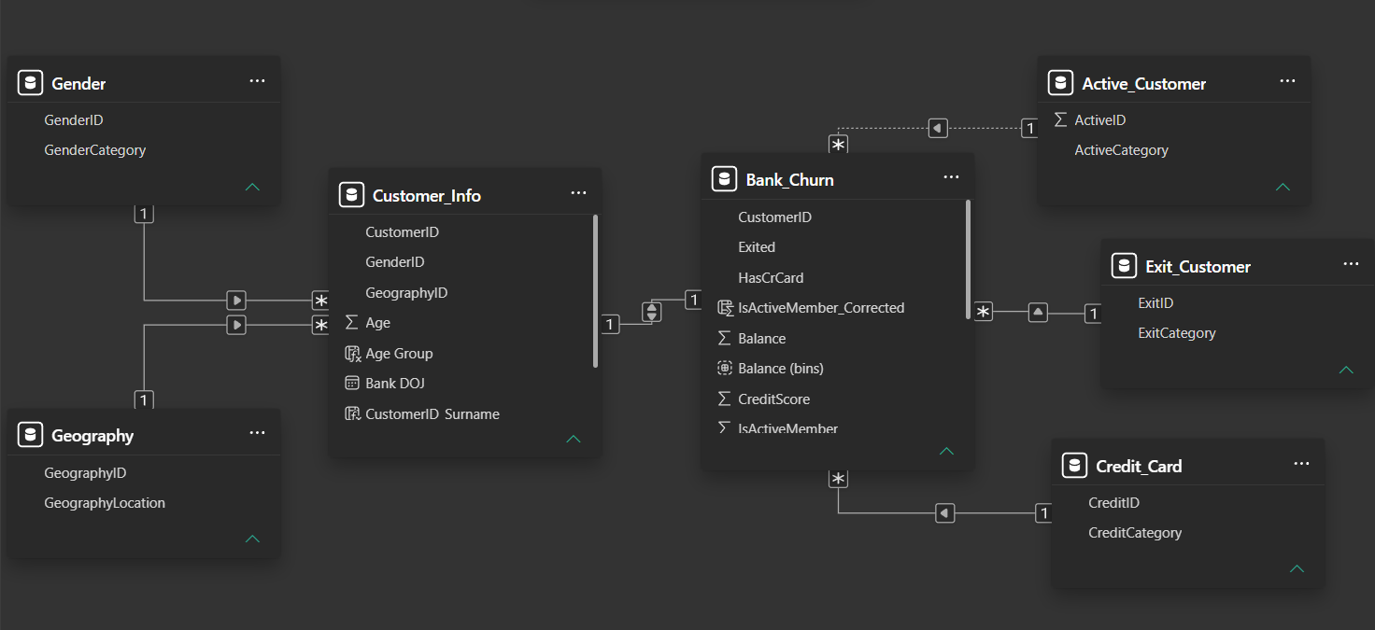
03 · DATA FOUNDATION (DATABASE SCHEMA)

Slide 7
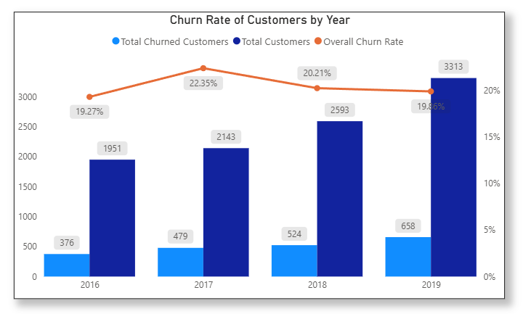
04 · CHURN LANDSCAPE
A Persistent ~20% Churn Rate, Year After Year
YEAR-BY-YEAR
2016
19.27%
2017
22.35%
2018
20.21%
2019
19.86%
2017 marked the peak of attrition. Despite year-over-year fluctuation, churn has never dropped below 19% — this is a structural issue, not a one-time event.

Slide 8
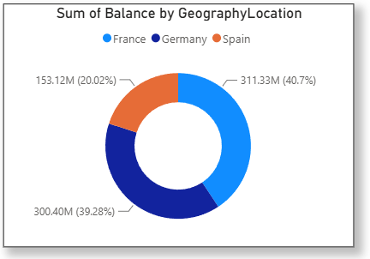
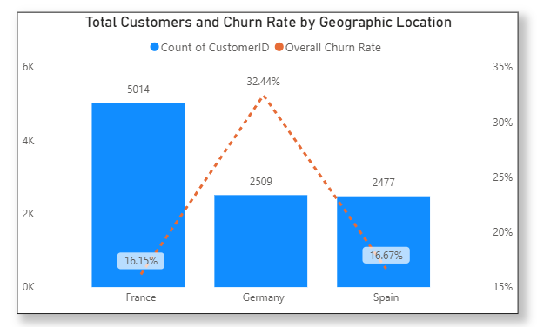
04 · CHURN LANDSCAPE
Germany: Smaller Base, Bigger Risk
Sum of account balance by geography
Total customers and churn rate by region
France holds the largest active base and the highest total balance (40.7%).
Germany has the fewest active members yet the highest churn rate and highest average balance among exits — the bank’s clearest financial risk.

Slide 9
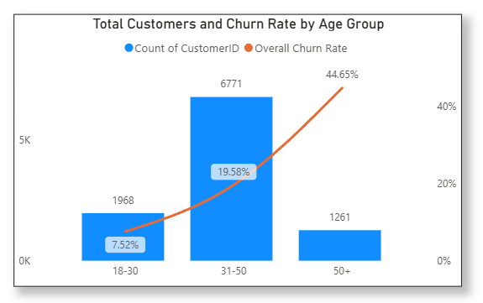
04 · CHURN LANDSCAPE
Churn Risk Climbs Sharply After Age 50
50+ years
Highest churn segment — nearly 1 in 2 leave
44.65%
31–50 years
Moderate risk — the largest customer group
19.58%
18–30 years
Most loyal segment by a wide margin
7.52%

Slide 10
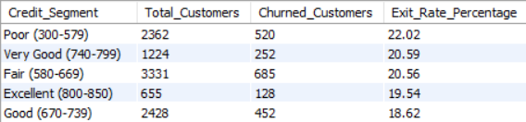
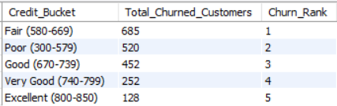
04 · CHURN LANDSCAPE
Weaker Credit Health, Higher Exit Risk
CUSTOMERS SEGMENTED BY CREDIT SCORE — EXIT RATE
READING THE TWO VIEWS
Exit rate isolates risk per segment. Churn volume shows where the customer base is concentrated.
“Fair” (580–669) sees the most churned customers in raw numbers simply because most customers fall in that range — while “Excellent” (800–850) sees the fewest, both in share and volume.
Poor credit (300–579) customers churn at 22.02% — the highest of any credit segment.
CHURN VOLUME BY CREDIT SCORE BUCKET
Implication
Credit health is a genuine early-warning signal — not just a lending metric.

Slide 11
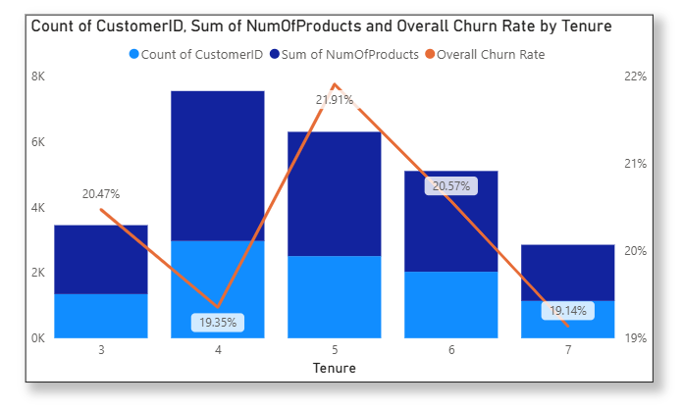
04 · CHURN LANDSCAPE
Loyalty Builds with Tenure — Until Year Five
WHAT THE DATA SHOWS
4-year customers spend more.
Tenure builds engagement and share-of-wallet over time.
5-year customers churn more.
A distinct spike in attrition appears right at the 5-year mark.
Loyalty compounds — mostly.
Overall, longer-tenured customers are stickier, but year 5 is a watch-point worth a dedicated retention touchpoint.

Slide 12
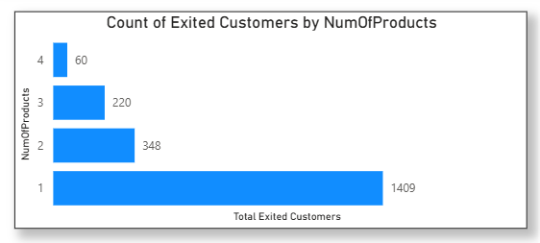
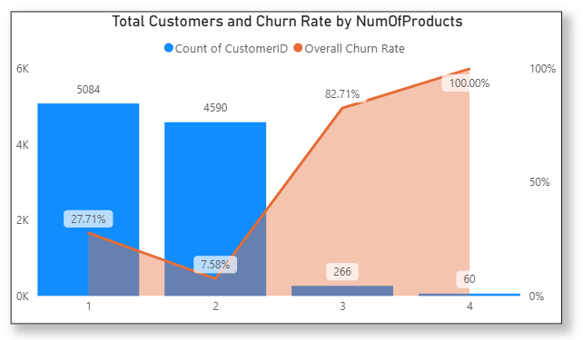
04 · CHURN LANDSCAPE
More Products, Stronger Loyalty
Exited customers by number of products held
Churn rate by product-holding pattern
1,409 of all exited customers held just one product — by far the most common profile among leavers. Product depth is structural loyalty.

Slide 13
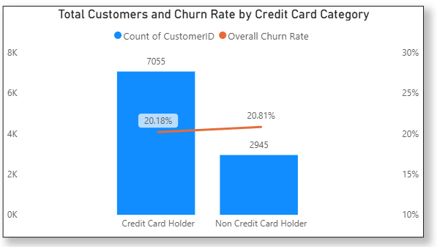
04 · CHURN LANDSCAPE
Credit Card Ownership: Not the Differentiator You'd Expect
20.18%
churn among credit card holders (7,055 customers)
20.81%
churn among non-holders (2,945 customers)
A 0.63-point gap is statistically negligible. Card ownership alone should not be treated as a retention lever — the bank’s effort is better spent elsewhere.

Slide 14
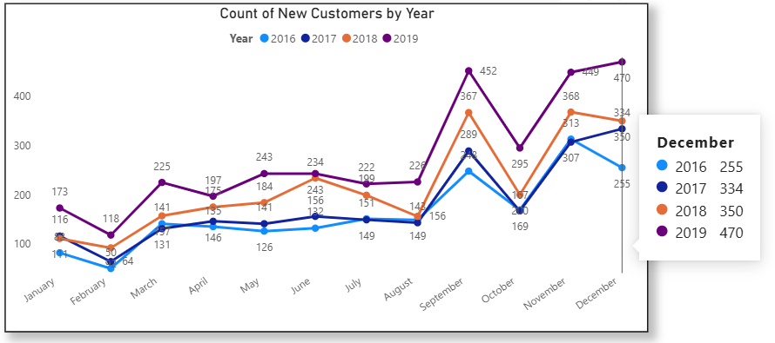
04 · CHURN LANDSCAPE
The Bank's Seasonal Pulse of New Customers
Spikes in March, September & November every year
Dips in February & October — a reliable seasonal rhythm worth planning acquisition campaigns around.

Slide 15
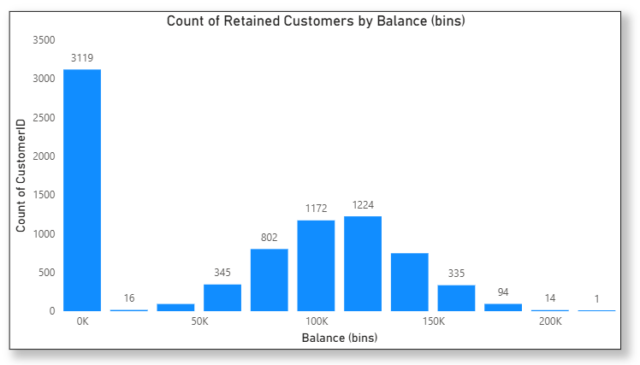
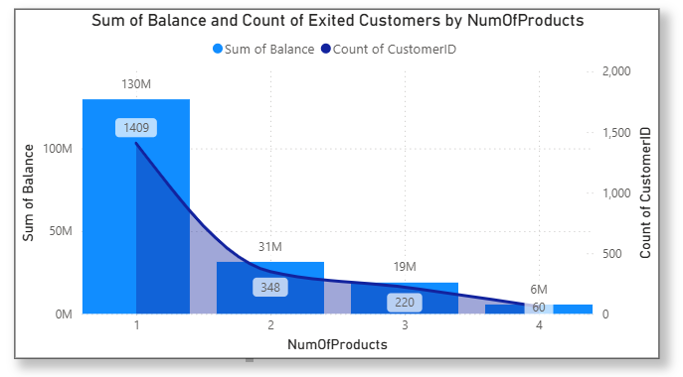
04 · CHURN LANDSCAPE
Most Loyal Customers Carry Little to No Balance
Balance distribution — retained customers
Balance & customer count by products — exited only
3,119 retained customers hold under $20K (many at $0) — low balance alone does not predict churn; it’s the norm, not a red flag.

Slide 16
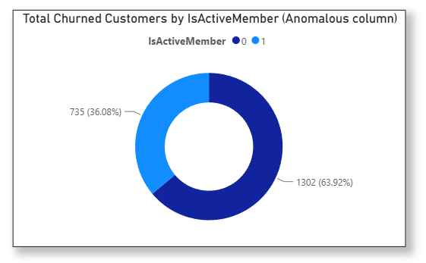
05 · ROOT CAUSE ANALYSIS
A Data Discrepancy Worth Fixing Before Any Model Runs
735
exited customers were still flagged “Active Member” in the source data
Logically, a customer who has left cannot still be active. This is a data-entry lag, not a true behavioral signal — and left uncorrected, it would quietly bias any churn model trained on this field.
THE FIX
A new field, IsActiveMember_Corrected, reclassifies every exited customer as Inactive — restoring logical consistency across the dataset.

Slide 17
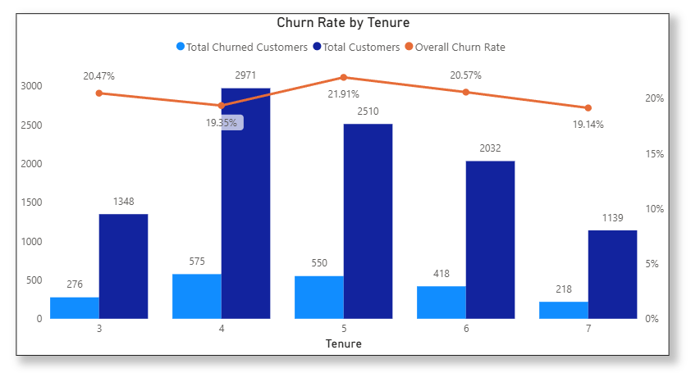
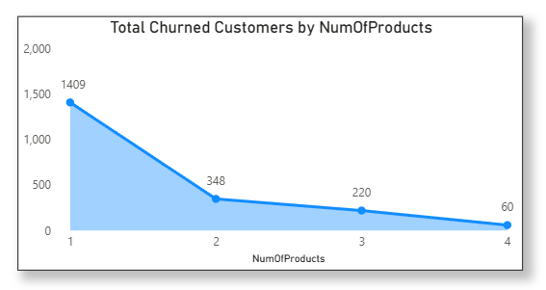
05 · ROOT CAUSE ANALYSIS
What Really Predicts Churn
Churn rate by tenure
Churn rate by number of products
Tenure
IsActiveMember
NumOfProducts
EstimatedSalary
STRONG
STRONGEST
STRONG
WEAKEST
Low tenure (0–1 yrs) is a volatile testing phase; established customers settle into a predictable 19–22% band.
Inactive members have often “mentally churned” already — the single strongest predictor in the dataset.
One product = zero switching cost, high churn. Three to four products = deep loyalty, rarely leave.
Surprisingly, raw income barely predicts loyalty — high earners churn for better rates just as easily.

Slide 18
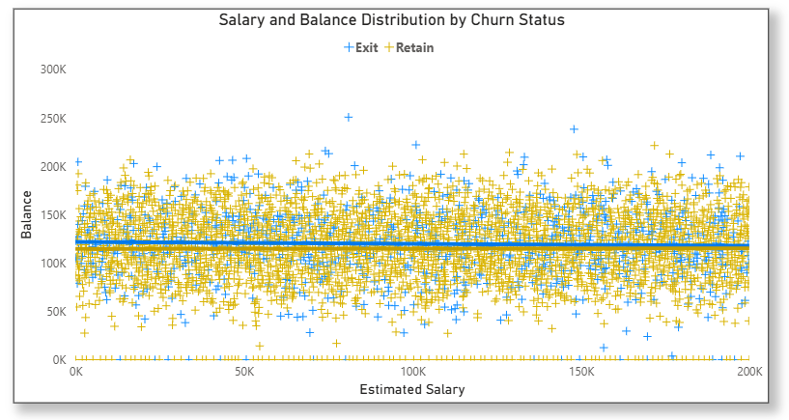
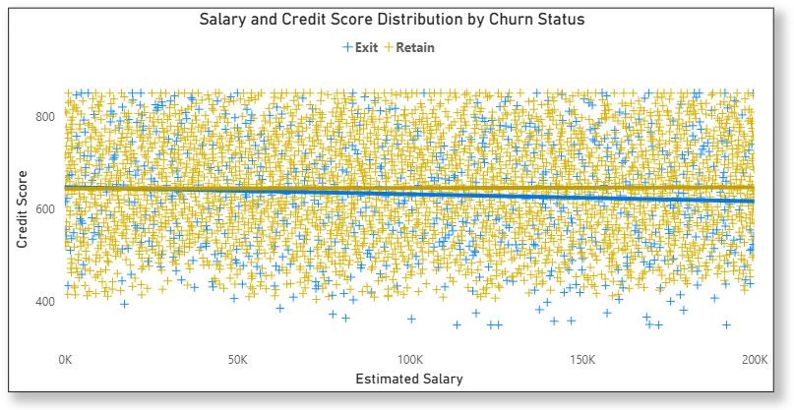
05 · ROOT CAUSE ANALYSIS
Two Dead Ends: Salary Explains Neither Balance Nor Credit Score
Salary vs. account balance, by exit status
Salary vs. credit score, by exit status
Both trendlines sit essentially flat — confirming near-zero correlation in both cases.
Salary is not a useful lens for predicting balance or creditworthiness; the bank should look to behavioral signals instead.

Slide 19
06 · STRATEGY & DASHBOARD
Why Customers Actually Leave
Demographic Vulnerability
Financial Profile Risk
Customers over 50 exit at nearly 45% — likely dissatisfaction with product fit, terminology, or a sense of being underserved.
A clear attrition trend exists among customers with credit scores below 700 — financial strain correlates with disengagement.
Geographic Hotspot
Service & Experience
Germany shows disproportionately high churn versus France and Spain, despite a smaller active base.
Poor customer satisfaction — slow support, long wait times, unresolved issues — remains a primary, human driver of churn.

Slide 20
06 · STRATEGY & DASHBOARD
From Insights to Actions
01
02
03
Target the 50+ segment
Deepen product relationships
Watch the year-5 cliff
Dedicated relationship managers, simplified product terms, and loyalty incentives for the highest-risk age group.
Proactively cross-sell single-product customers into a 2nd or 3rd product — the single biggest lever against churn.
Trigger a dedicated retention touchpoint (review call, loyalty reward) as customers approach their 5-year mark.
04
05
06
Prioritize Germany
Flag at-risk accounts in real time
Fix satisfaction at the source
Investigate service quality and local competitive pressure in Germany specifically — its churn is structurally out of line.
Use a CRM-native “Churn Risk” flag (inactive + single product) to surface accounts before they leave, not after.
Invest in support responsiveness and issue resolution speed — the most human, most controllable churn driver.

Slide 21
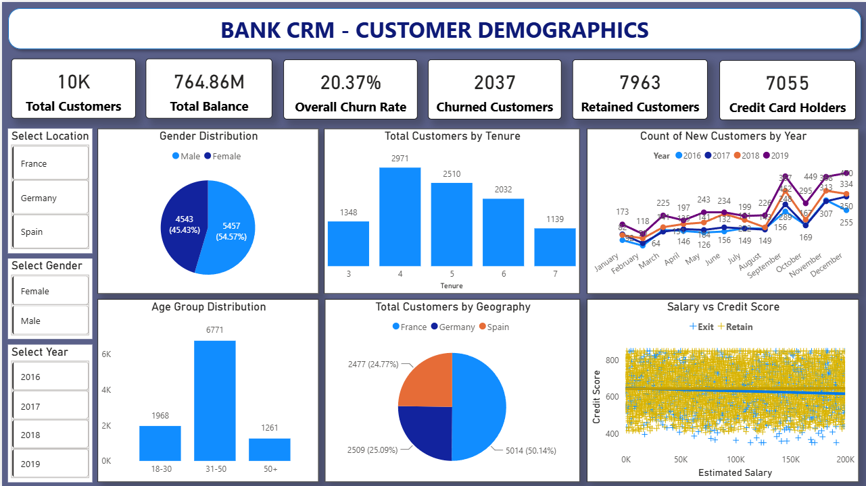
06 · STRATEGY & DASHBOARD
Customer Demographics Dashboard

Slide 22
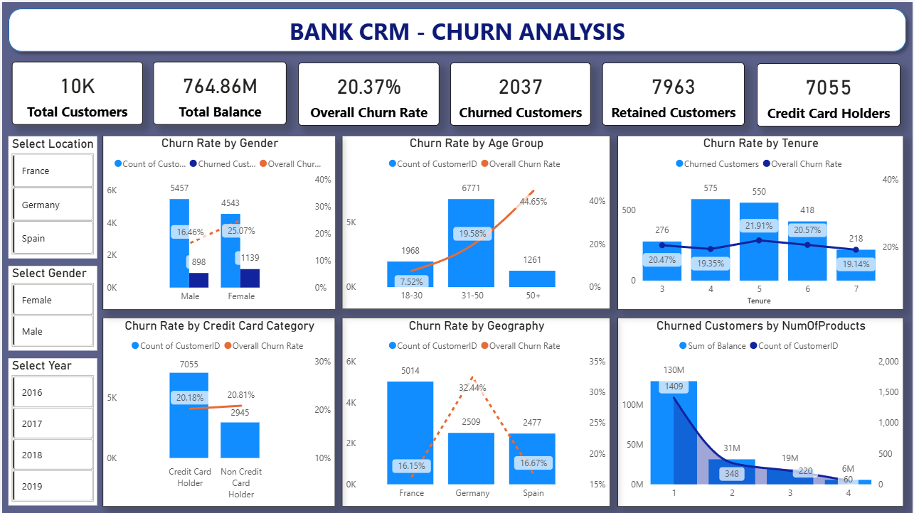
06 · STRATEGY & DASHBOARD
Churn Analysis Dashboard

Slide 23
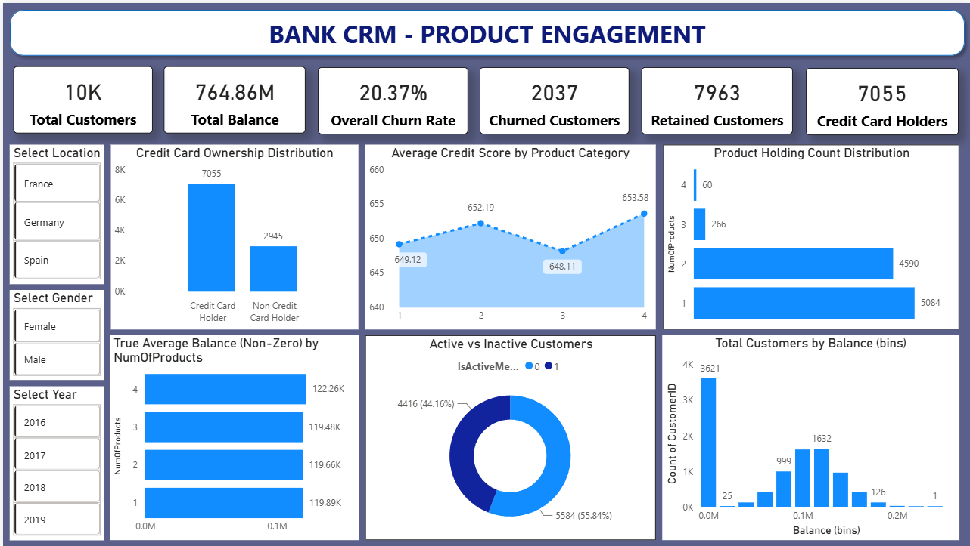
06 · STRATEGY & DASHBOARD
Product Engagement Dashboard

Slide 24
CONCLUSION
Key Takeaways for Bank Leadership
Churn has held steady near 20% for four straight years despite steady new-customer growth — acquisition alone cannot outrun this leak.
1
Risk concentrates predictably: customers 50+, single-product holders, inactive members, and lower credit scores.
2
Germany is a structural outlier — highest churn, fewest active members — and merits a dedicated regional review.
3
Product depth and active engagement are the strongest retention levers the bank directly controls.
4
A corrected, validated dataset and a live CRM risk flag now give the bank the foundation to act on all of this immediately.
5

Slide 25
Thank You
SHREYASH RAWAT | Capstone Project: Analytical CRM Development for a Bank

